Slide 1
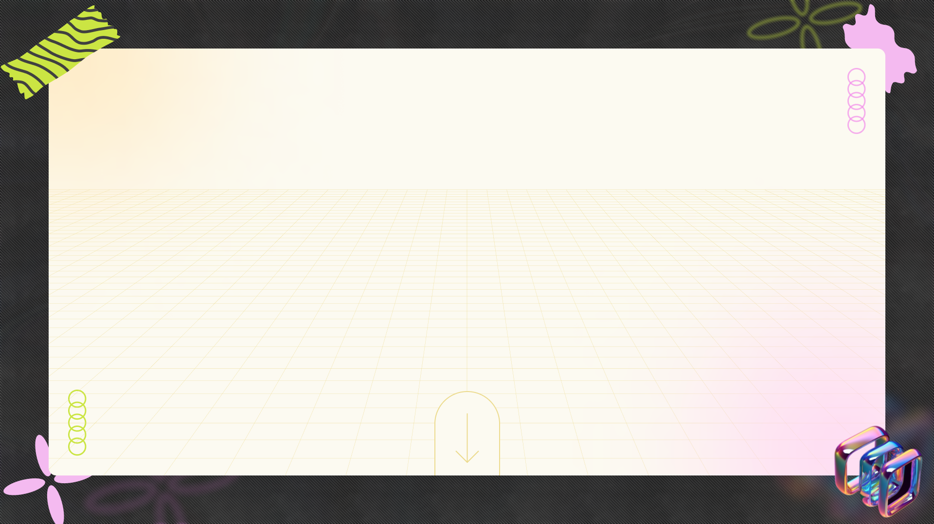
Unlocking Language Identification Technology
+
+
+
Discover the revolutionary language identifier transforming communication and translation across the globe.
+
+
+
Hariram jk (192211359)
Roshan (192210659)
Notes:
<number>

Slide 2



Table of content
01
Understanding Language Identification
02
How It Works
03
Why We Developed This Technology
04
Innovative Applications
05
Exploring Further: Translated Labs
06
Opportunity to Contribute
07
Spoken Language Identifier
08
Terminology Extractor Features
09
Future Prospects
Notes:
<number>

Slide 3
Table of content
10
Conclusion and Call to Action
11
Thank You!
Notes:
<number>

Slide 4


Understanding Language Identification
A language identifier is an automatic classifier that determines the language of a text.
It calculates text similarity by comparing it to previously stored reference texts.
This technology enables quick categorization of documents based on linguistic characteristics.
It's designed for diverse applications in translation and communication, enhancing global interactions.
Photo by Pexels
Notes:
<number>

Slide 5
How It Works
Utilizes a Vector Space Model to create an n-dimensional representation of text.
Statistical properties of byte sequences serve as coordinates in this model.
Texts are positioned in an n-dimensional space, enabling precise similarity assessments.
The closest reference text indicates the most similar language or category.
Photo by Pexels
Notes:
<number>

Slide 6

Why We Developed This Technology
The language identifier aids translators by extracting valuable information from the web.
It classifies documents to streamline the translation process effectively.
Allows identification of topics in languages the user may not understand.
Enhances communication efficiency in multilingual environments.
Photo by Pexels
Notes:
<number>

Slide 7

Innovative Applications
The technology can classify various types of documents swiftly and accurately.
It's used to enhance email correspondence classification and topic identification.
Supports language recognition in real-time applications across industries.
Facilitates better understanding and accessibility of information.
Photo by Pexels
Notes:
<number>

Slide 8

Exploring Further: Translated Labs
For more insights about language processing, visit Translated Labs for extensive research.
Discover various services that utilize language identifiers for practical applications.
Engage with publications that highlight advances in translation technology.
Stay updated on innovations that impact global communication.
Photo by Pexels
Notes:
<number>

Slide 9

Opportunity to Contribute
We're always seeking talented engineers with a global perspective.
Join our mission to improve language processing applications.
Your expertise can drive advancements in translation technology.
Get in touch to explore opportunities with us!
Photo by Pexels
Notes:
<number>

Slide 10
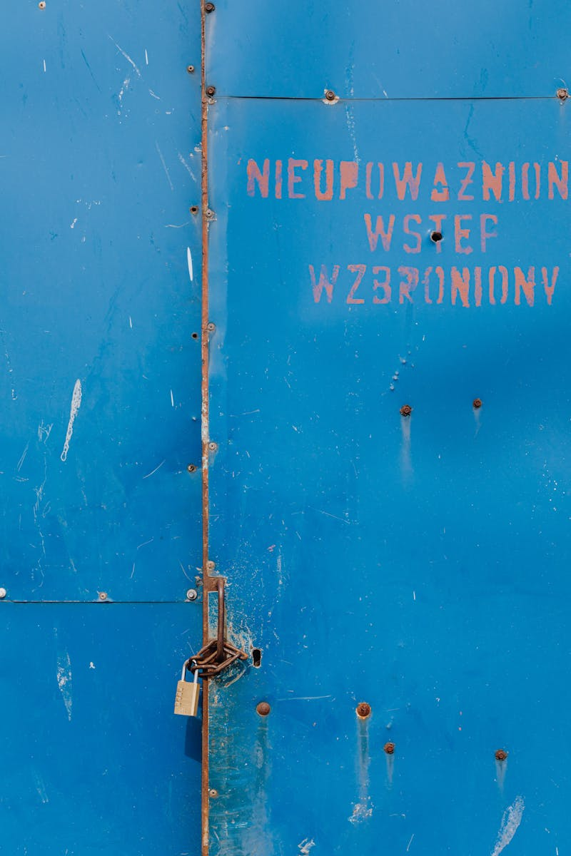
Spoken Language Identifier
This tool automatically detects the language of spoken text, expanding functionality.
Supports classification of recordings ranging from 1 second to 1 minute.
Currently, it recognizes eight diverse languages, enhancing accessibility.
Ideal for applications in language learning and real-time translation.
Photo by Pexels
Notes:
<number>

Slide 11

Terminology Extractor Features
Automatically extracts terminology from technical documents, aiding translators.
Facilitates identification of challenges specific to technical categories.
Helps improve the quality and accuracy of translations in specialized fields.
A crucial tool for professionals managing multilingual content.
Photo by Pexels
Notes:
<number>

Slide 12

Future Prospects
Continual development is essential for improvements in language processing tools.
Innovations in AI can further enhance accuracy and efficiency.
There's a growing demand for technology that supports multilingual communications.
Embrace opportunities to contribute to the future of language identification.
Photo by Pexels
Notes:
<number>

Slide 13

Conclusion and Call to Action
Language identification technology is reshaping the future of translation and communication.
Photo by Pexels
Notes:
<number>

